Slide 1

Topic Modelling
Anshu Pandey

Slide 2
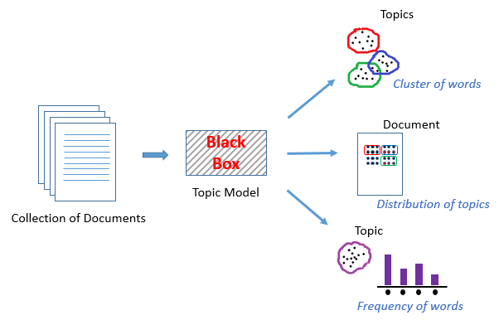
Topic modelling
A Topic Model can be defined as an unsupervised technique to discover topics across various text documents. These topics are abstract in nature, i.e., words which are related to each other form a topic.

Slide 3
Use-Cases of Topic Modelling
Resume Summarization: It can help recruiters to evaluate resumes by a quick glance. They can reduce effort in filtering pile of resume.
Search Engine Optimization: online articles, blogs, and documents can be tag easily by identifying the topics and associated keywords, which can improve optimize search results.
Recommender System Optimization: recommender systems act as an information filter and advisor according to the user profile and previous history. It can help us to discover unvisited relevant content based on past visits.
Improving Customer Support: Discovering relevant topics and associated keywords in customer complaints and feedback for examples product and service specifications, department, and branch details. Such information help company to directly rotated the complaint in respective department.
In the healthcare industry, topic modeling can help us to extract useful and valuable information from unstructured medical reports. This information can be used for patients treatment and medical science research purpose.

Slide 4
LDA – Latent Dirichlet Allocation
A topic is nothing but a collection of dominant keywords that are typical representatives. Just by looking at the keywords, you can identify what the topic is all about.
Topic modeling is an exploratory tool frequently used in text mining.
Topic Modeling is a technique to extract the hidden topics from large volumes of text.
LDA or Latent Dirichlet Allocation is a generative model used extensively for modeling large text corpora.
In addition to being an exploratory tool, LDA can also be used as a feature selection technique for text classification and other tasks.

Slide 5
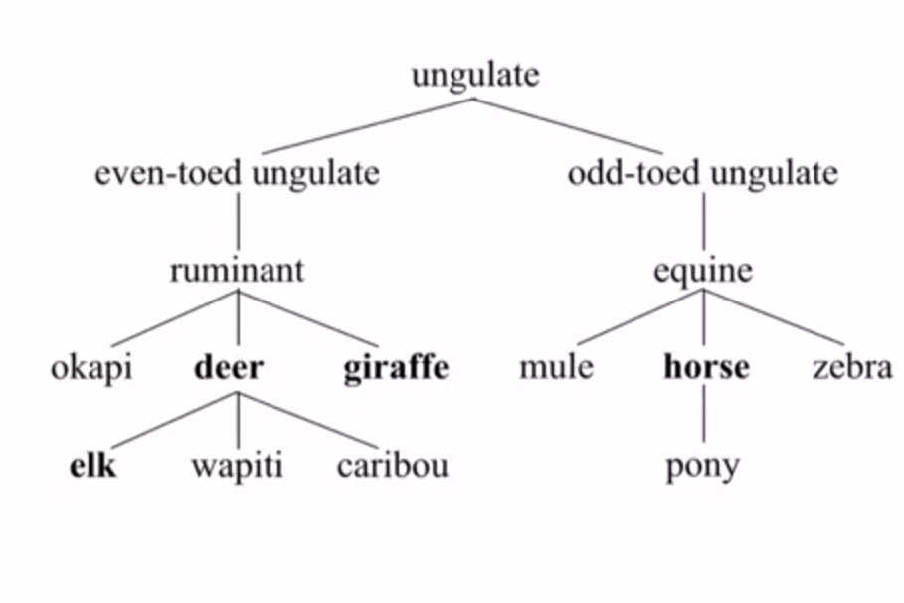

Slide 6
What lda does?
LDA’s approach to topic modeling is it considers each document as a collection of topics in a certain proportion. And each topic as a collection of keywords, again, in a certain proportion.
Once you provide the algorithm with the number of topics, all it does it to rearrange the topics distribution within the documents and keywords distribution within the topics to obtain a good composition of topic-keywords distribution.

Slide 7
Tips to improve results of topic modeling
1. Frequency Filter – Arrange every term according to its frequency. Terms with higher frequencies are more likely to appear in the results as compared ones with low frequency. The low frequency terms are essentially weak features of the corpus, hence it is a good practice to get rid of all those weak features.
2. Part of Speech Tag Filter – POS tag filter is more about the context of the features than frequencies of features. Topic Modelling tries to map out the recurring patterns of terms into topics. However, every term might not be equally important contextually. For example, POS tag IN contain terms such as – “within”, “upon”, “except”. “CD” contains – “one”,”two”, “hundred” etc. “MD” contains “may”, “must” etc. These terms are the supporting words of a language and can be removed by studying their post tags.
3. Batch Wise LDA –In order to retrieve most important topic terms, a corpus can be divided into batches of fixed sizes. Running LDA multiple times on these batches will provide different results, however, the best topic terms will be the intersection of all batches.

Slide 8
Working of LDA
Suppose we have a collection of documents and we want to learn `K` topics out of them.
We will go through each document (d).
Then for each word (w) in the document we will calculate the following:-
X = p(topic | document) = the proportion of words in document d that are currently assigned to topic t.
Y = p(word w | topic t) = the proportion of assignments to topic t over all documents that come from this word w. (The same word can be in multiple documents, hence its coverage over the documents)
X * Y is essentially the probability that topic `t` generated word `w`, so it makes sense that we re-sample the current word’s topic with this probability.

